Slide 1




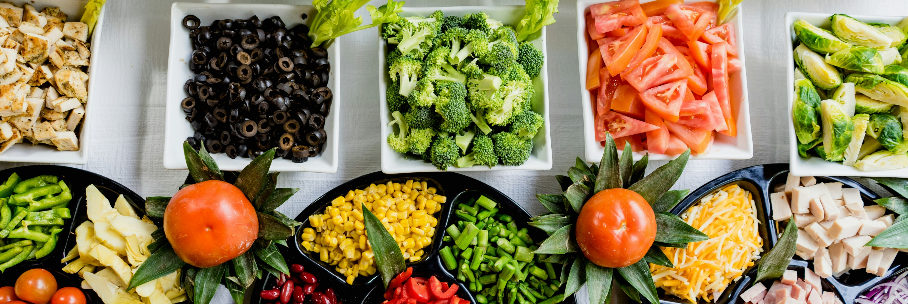

Reducing Food Waste in Food Production Stages Utilizing Machine Learning
Presented by:
Team NaN.00013

Slide 2
The problem
Final product: 105g
💸
Final product: 99.8g
Input weight:
108g
⛔
🍖
🥩
Packaging
Storage
Cooking
Preproduction
Standard product:
100g
Communication channel
is not set up properly

Slide 3
The solution → Minimize human input
Start
Start
Machine
Human input
Extract data from SAP real-time
Get error notification when there is deviation
Make prediction based on data import
Verify the problem from current stage or not
Start
Close the error by either fix issue or report back to previous stage
End
Send back to each stage the estimation
Display the estimation to employees
Start
Machine
Compare estimation with
real-time data at each stage
Adjust prediction model if none of the stage found root cause for the deviation

Slide 4
Data handling

Slide 5
Prototype

